Slide 1
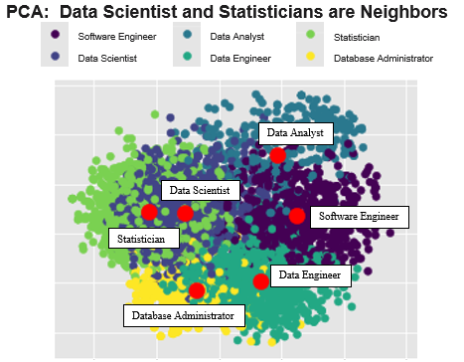
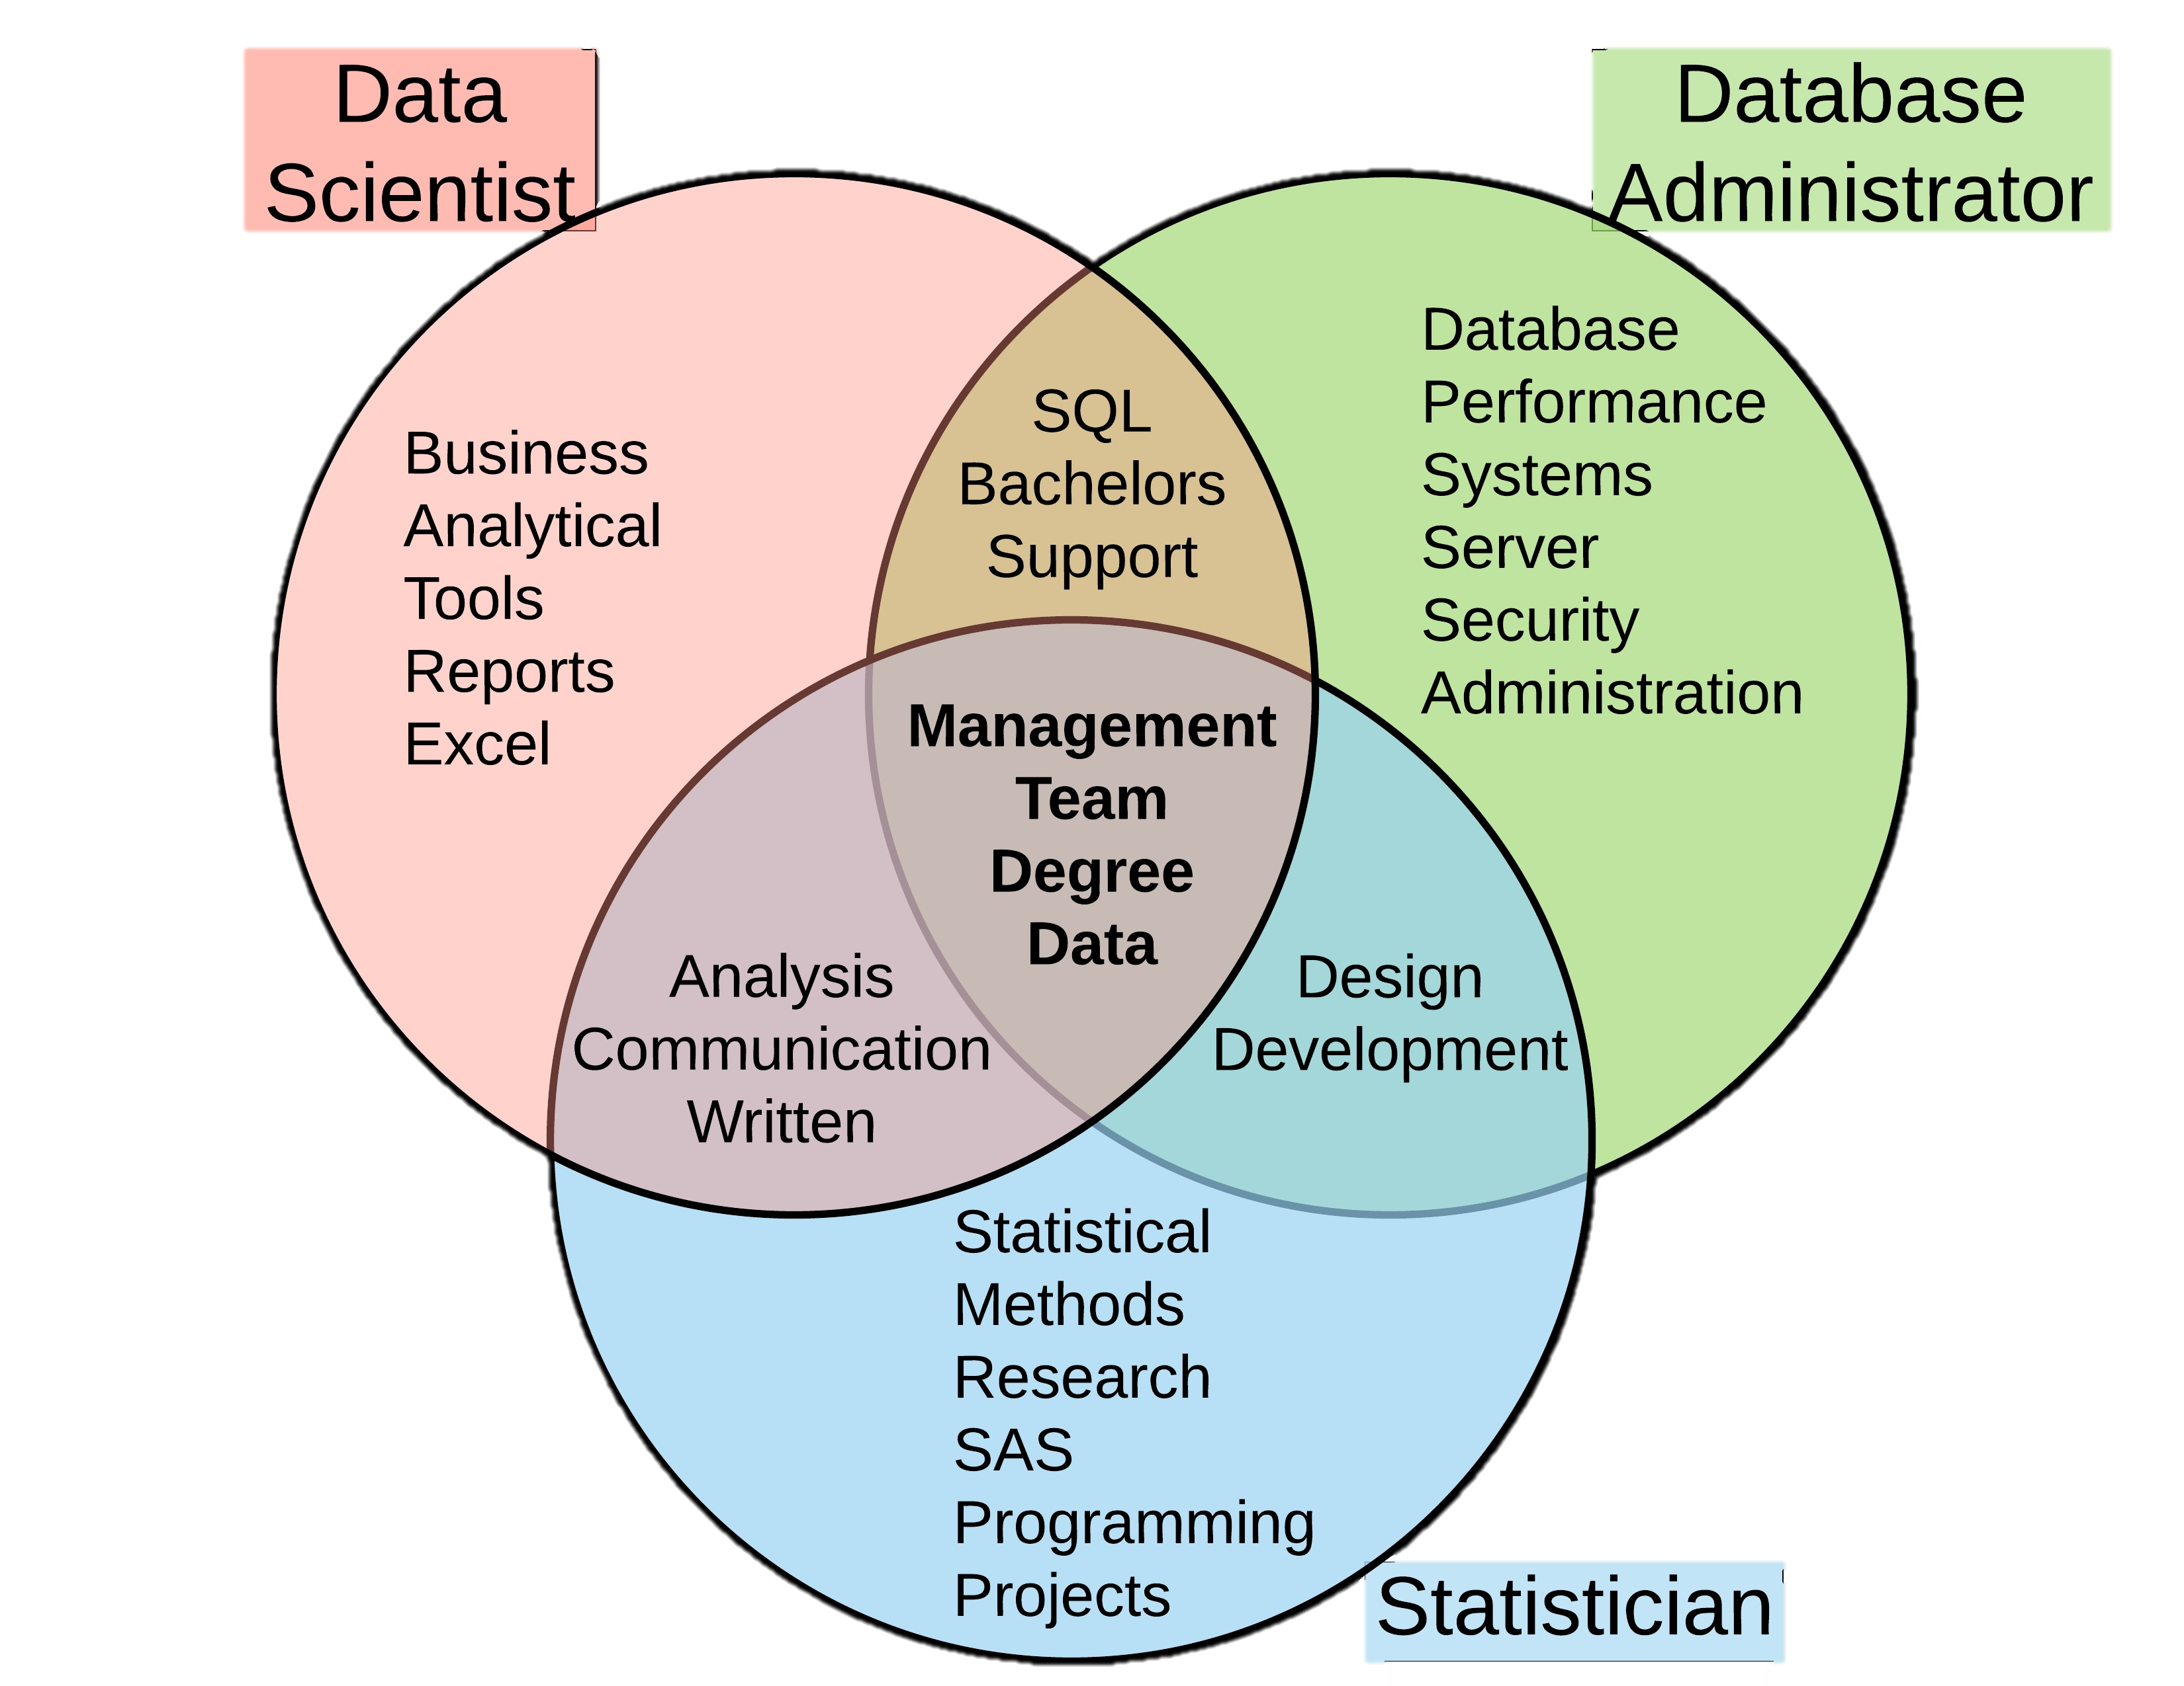
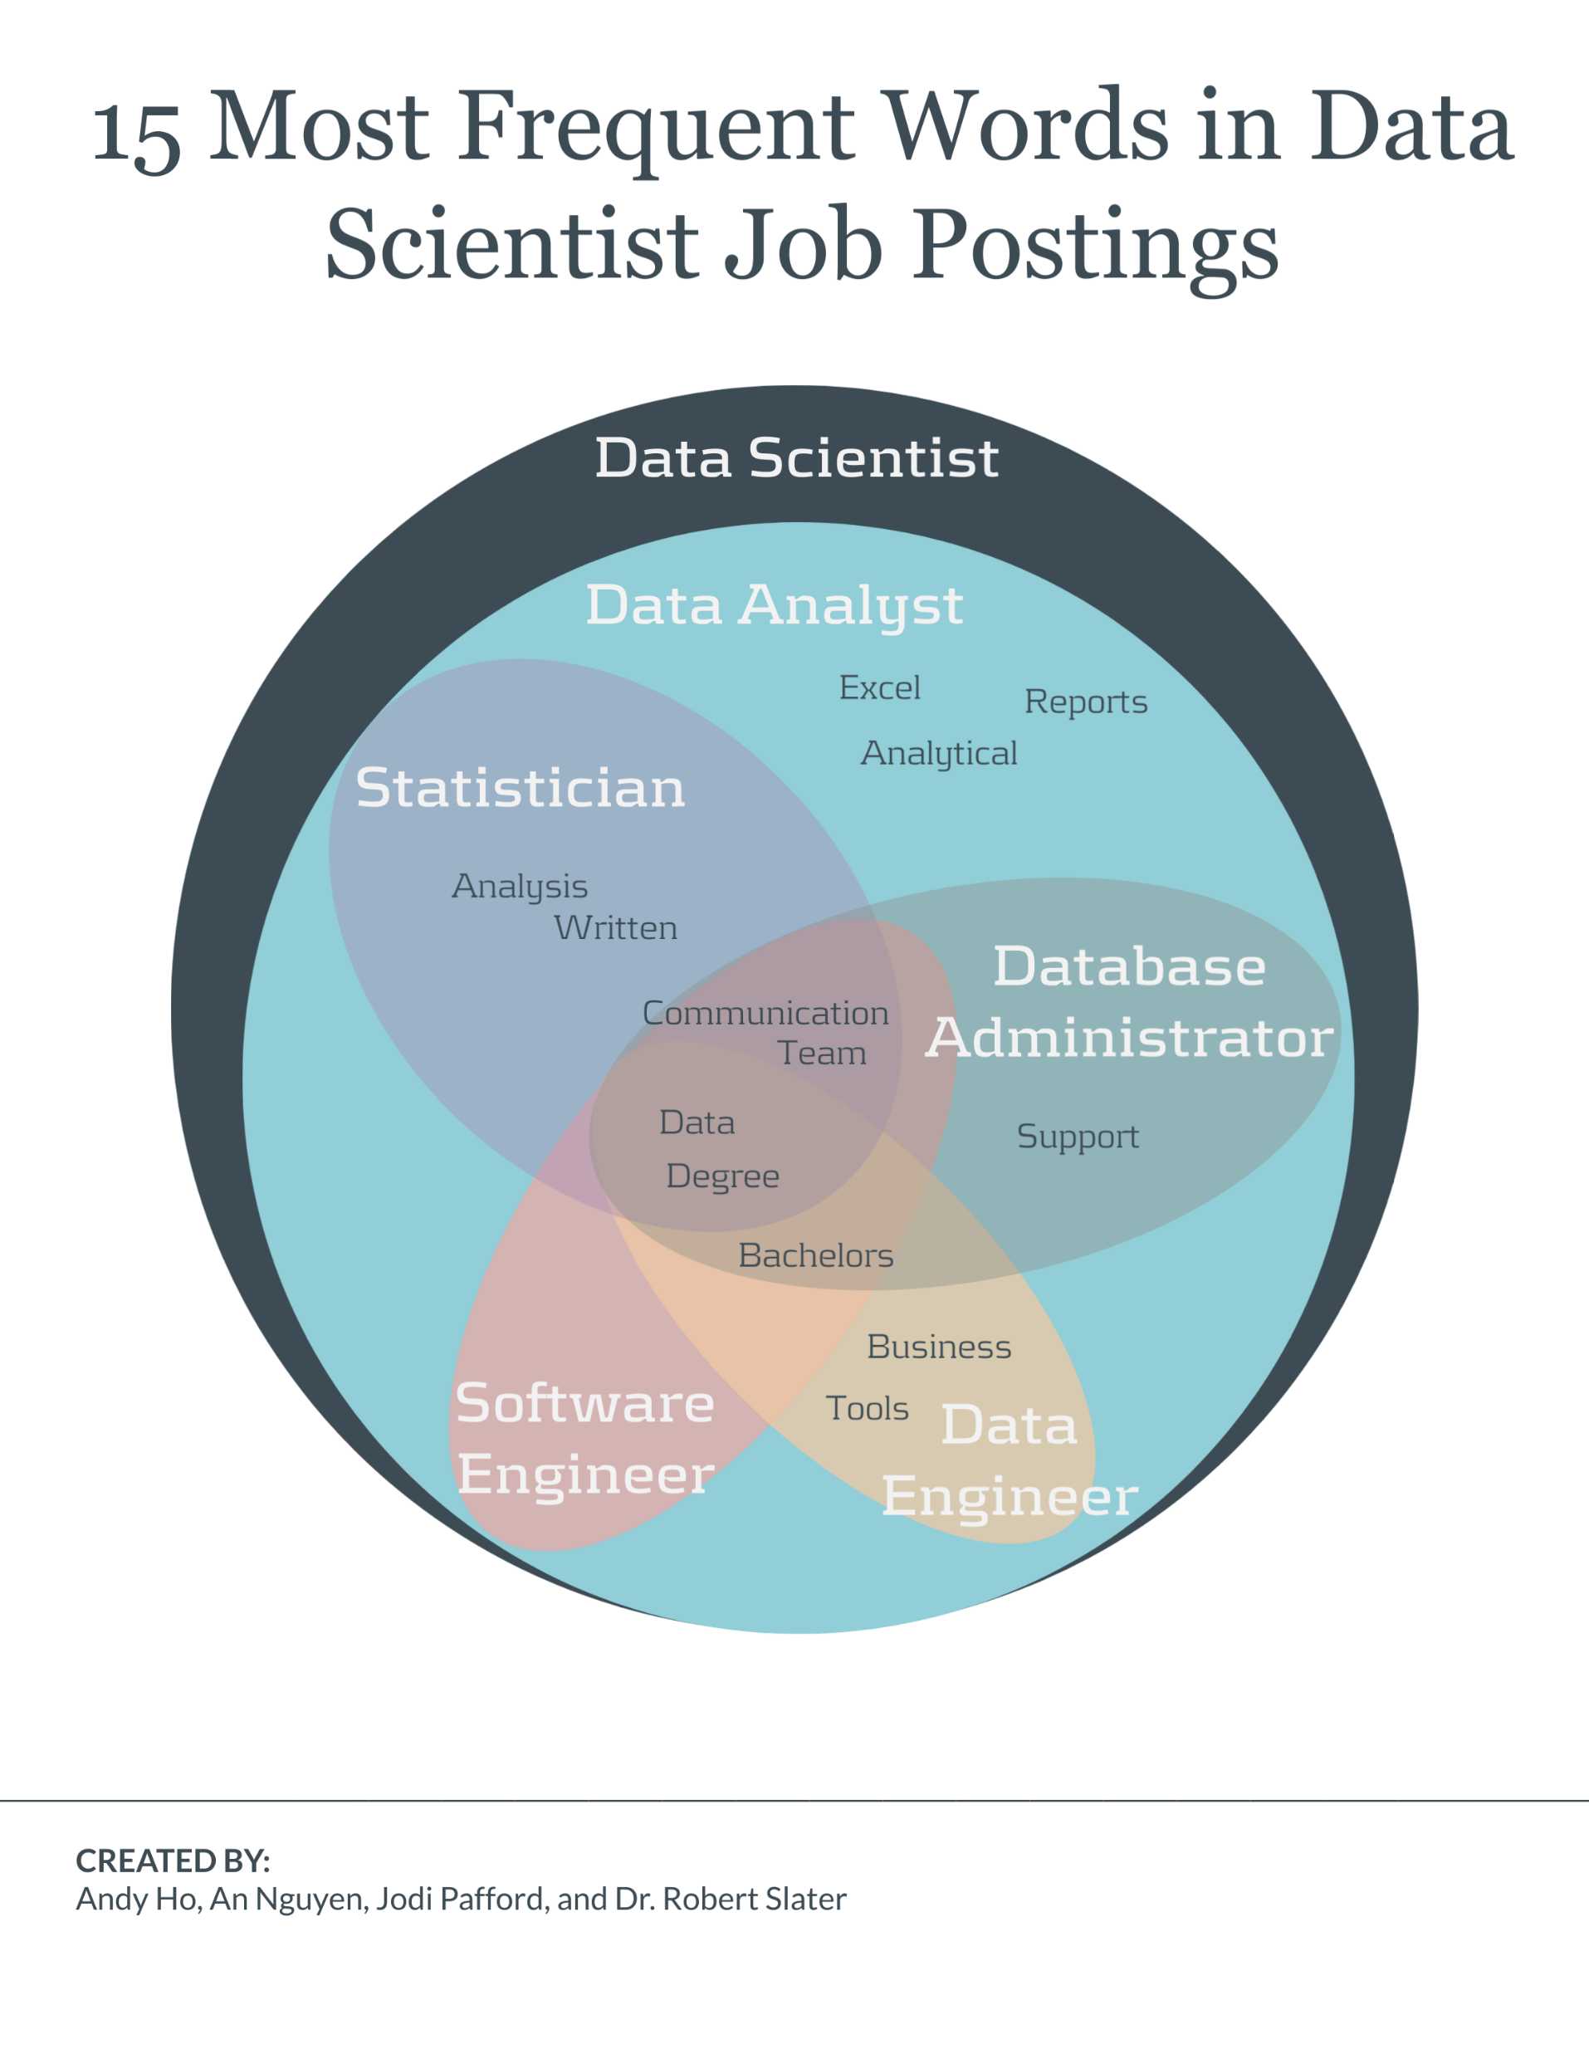

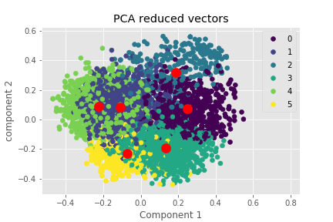
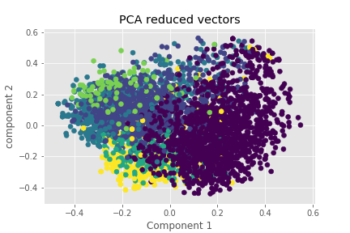
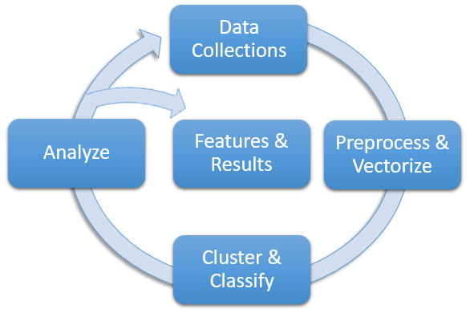
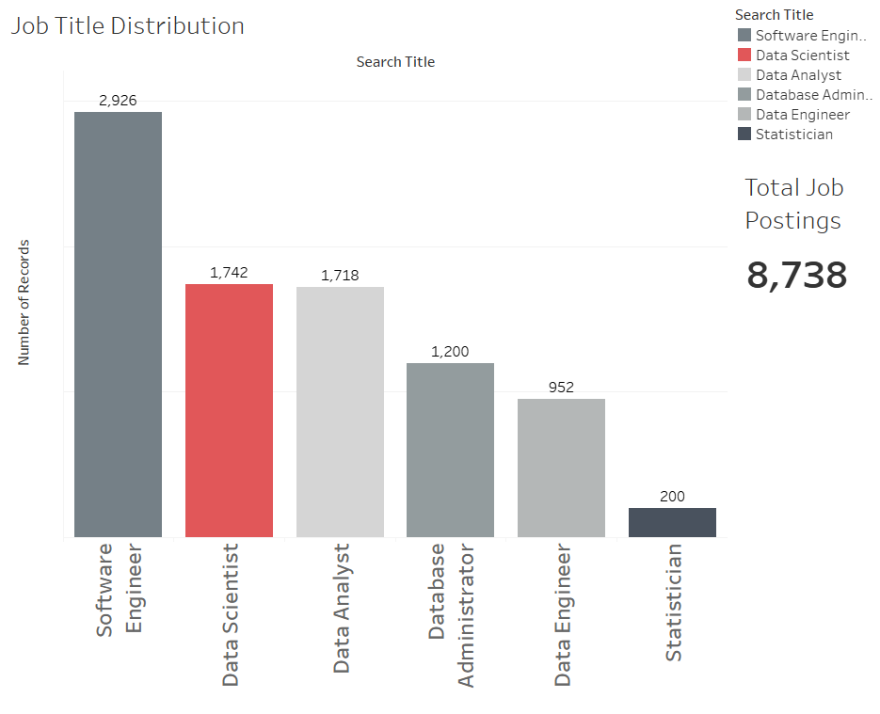
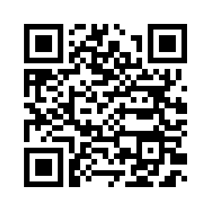



Who or What is a Data Scientist?
Method
Web scrapped 8,000+ job postings to form data set
Transform into feature vectors using Universal Sentence Encoder
Labeled clustering and neural network for classification
Reverse engineered results to find Features of Importance
Kmeans Clustering
Neural Net Clustering
85% accuracy in classification
Non-Cognitive Predictors of Student Success: A Predictive Validity Comparison Between Domestic and International Students
Non-Cognitive Predictors of Student Success: A Predictive Validity Comparison Between Domestic and International Students
Introduction
The definition of a Data Scientist is undecided - leading to unmet expectations, misfit hires, and lost time/resources for employers, employees, and applicants. Using state-of-art NLP and Machine Learning on 8,000+ job postings, we arrive at the features that define the ‘what is’ and cluster other job titles to understand the ‘who is’ a Data Scientist.
A Data Science Approach to Define the Data Scientist
PCA: Data Scientist and Statisticians are Neighbors
Data Analyst
Data Scientist
Software Engineer
Statistician
Data Engineer
Database Administrator
Software Engineer Data Analyst Statistician
Data Scientist Data Engineer Database Administrator
Data Analyst
Data Set Distribution by Titles
Data Scientist
A Data Scientist is a statistician who can code, communicate, and collaborate.
Software Engineer
2,926
Statistician
1,742
1,718
Data Engineer
1,200
200
952
Database
Administrator
Software Engineer
Data Scientist
Data Analyst
Database Administrator
Data Engineer
Statistician
Andy Ho An Nguyen Jodi Pafford
Dr. Robert Slater
Master of Science in Data Science
Interact with our data by visiting our Tableau Website
Southern Methodist University
Dallas, TX 75375, USA
Notes:
Notes:
In Powerpoint, click View > Guides
Keep text within gutter guides.
Author list: Don’t split names onto two lines (e.g., “Jimmy [break] Smith”). If that happens, use a new line, unless you need the space. Bold the first names of anybody who’s presenting in person.
Intro/methods/result: Do not drop below font size 28, but if you have extra space, jack up the font size until the space is full.
Do not use color in the sidebars except in graphs/figures. It’ll pull attention from the center and slow interpretation for passersby.

